Slide 1
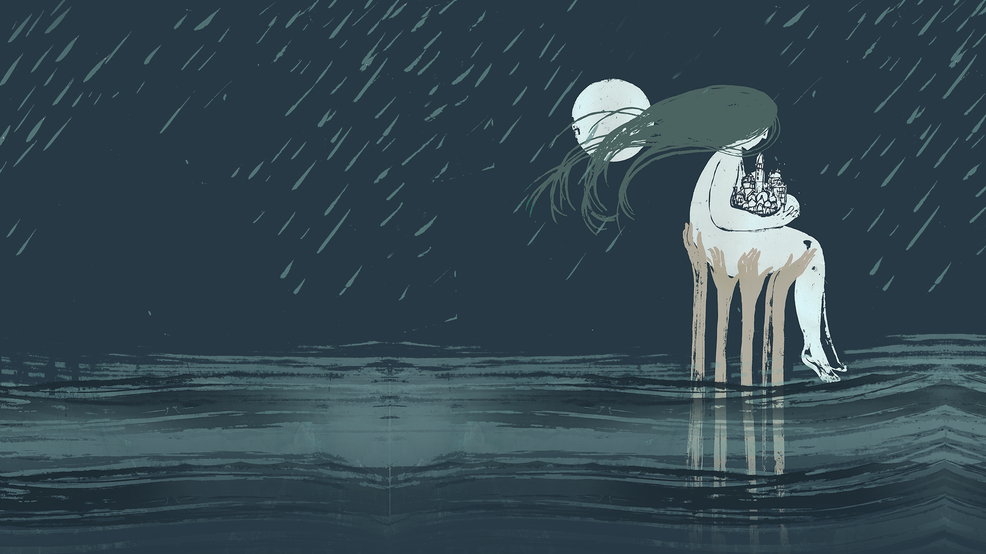
Creating a Community Digital Memory Archive
A presentation by The AquaGranda Team
AquaGranda is part of the ODYCCEUS project that has received funding from the
European Union's Horizon 2020 research and innovation programme under grant agreement No. 732942.

Slide 2
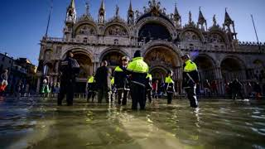
Notes:
General - Project Presentation
In November 2019, the city of Venice was hit by an extreme tide of 187cm, causing a catastrophic flooding known as "Aqua Granda". The flood had a devastating impact not only on ground floors, shops, and historical buildings, but above all it damaged an already fragmented and weakened local community and its socio-economic fabric. Behind the sensationalistic images of an extreme event captured by international media, lies a vulnerable ecosystem and population that, for centuries, has been developing alternatives to live in balance with nature. The AquaGranda (AG) project is a living digital community-memory about this collective struggle, unfortunately common to many other coastal areas around the world. Using leading-edge open-source data collection and analysis methods and AI tools developed in the EU project ODYCCEUS, the project archives data from numerous sources such as social media, meteorological measurements, and administrative reports. The AG digital community memory allows anyone to access, augment and (re)interpret its contents. Its scope is to highlight the role of memory in activating processes of community-driven design of climate change mitigation strategies and facilitate climate-change adaptation. The project aims to raise awareness locally and internationally, and to help the community self-organize, according to major sustainability principles.

Slide 3
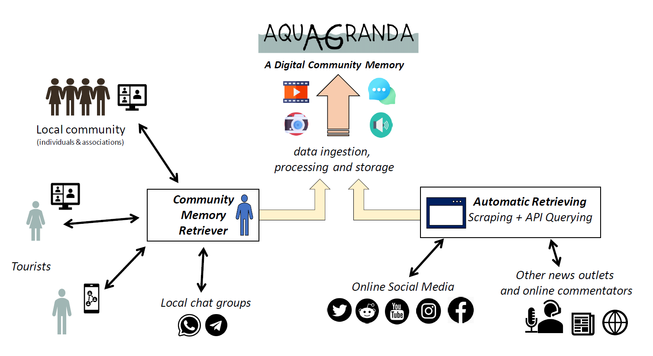
AquaGranda - Process
Notes:
Gathering memories
Automatic retrieving - A significant portion of the information about this high tide was spontaneously shared online at the time of the 2019 high tide. The Web and its apps, which are now easily accessible even during extreme events, allowed anyone who wished to do so to report online in real time, stories and emotions experienced in every corner of the city. Social media could therefore be used as a time machine for Web 'archaeologists' in order to digitally memorize how the event was perceived by the community when it took place. This was our attempt in the creation of the archives and the subsequent exhibition.
One of the critical issues in the creation of this memory was to define a strategy for finding, collecting and cataloguing online information about the event. The automation of data collection, through open-source programmes developed and used in the ODYCCEUS project (such as DMI-4CAT and Penelope ), makes it possible to collect large volumes of data from social media in a short time.
Community memory campaign - The AG project is special because of its relationship with technology. The same digital technologies and platforms that made our world more fragmented, polarized, and focused on the present, through AG have proved that they can help us to create, exchange, preserve, and activate memories and trigger collective action.
To ensure inclusivity, the project carried out a "memory donation" campaign aimed at those categories of citizens who are usually excluded by the digital divide. Thousands of audio-visual memory fragments were collected in this way and uploaded to the AG platform.

Slide 4
AquaGranda - Bringing memories to surface
The digital material we have collected in our Archive
manual
instagram
twitter
...
image
video
+40k media
contents
media
audio
document
How we have returned it to the community
2021 - Oral History Labs
2021 - Tour, workshops, events
2022 - Physical Exhibition
2022 - Linke & Bruno seminar
+100 activities
2021 - Archive
2021 - Digital exhibition
2021 - Catalog, articles Podcast
2022 - Tour, workshops, events
Notes:
How to transform memories in community’s heritage

Slide 5
AquaGranda - Communities & Venice
Notes:
summary activities 2021-2023

Slide 6
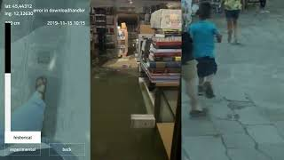
AquaGranda - Memories for Crisis Management
Notes:
Both documentation and reproduction of the catastrophic event

Slide 7
www.aquagrandainvenice.it

